Slide 1
PPT
ON
DIGITAL MARKETING

Slide 2
KEYPOINTS
What is digital marketing
Benefits of digital marketing
What does digital marketing consist of
SEO
PPC
SMM
Content writing
Digital marketing measurement

Slide 3

DEFINITION
Digital marketing is an umbrella term for the marketing of products or services using digital technologies, mainly on the Internet, but also including mobile phones, display advertising, and any other digital medium.

Slide 4
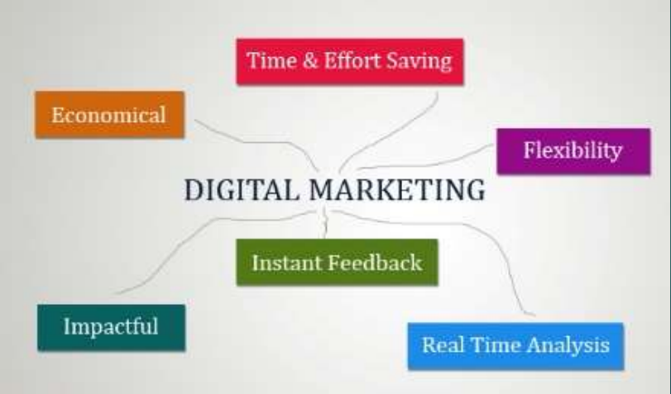
BENEFITS OF DIGITAL MARKETING

Slide 5

OBJECTIVE
Reach the right audience
Engage with your audience
Motivate your audience to take your action
Maximize return on investment(ROI)

Slide 6
DIGITAL MARKETING TOOLS
Sprout Social
Offerpop
Nanigans
Facebook’s Power Editor
Twitter Native Platform
Emma
Marketo
AdRoll

Slide 7
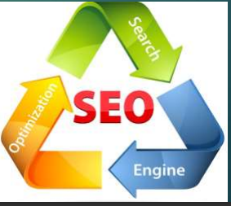
WHAT IS SEO
Whenever you enter a query in a search engine and hit 'enter' you get a list of web results that contain that query term. Users normally tend to visit websites that are at the top of this list as they perceive those to be more relevant to the query. If you have ever wondered why some of these websites rank better than the others then you must know that it is because of a powerful web marketing technique called Search Engine Optimization (SEO).

Slide 8
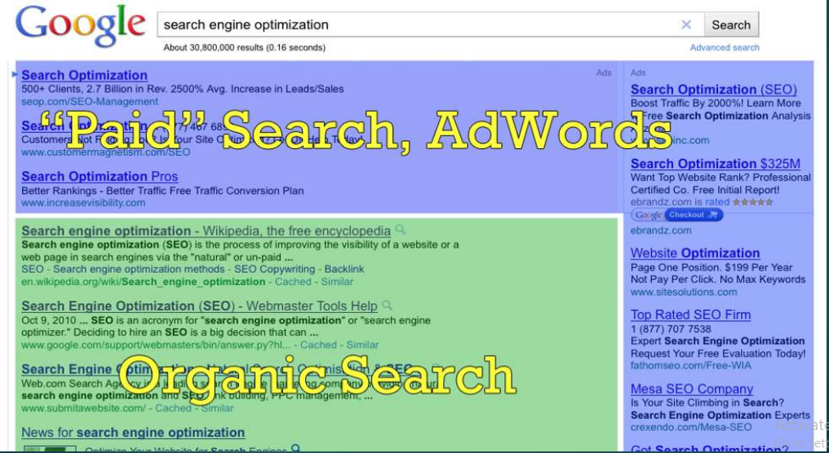
OPTIMIZATION

Slide 9

PPC(PAY PER CLICK)
What is PPC (pay-per-click) marketing? Pay-per-click marketing is a way of using search engine advertising to generate clicks to your website, rather than “earning” those clicks organically

Slide 10

WHAT IS SMM
Social media marketing (SMM) is a form of Internet marketing that utilizes social networking websites as a marketing tool. The goal of SMM is to produce content that users will share with their social network to help a company increase brand exposure and broaden customer reach.

Slide 11

CONTENT WRITING
A website content writer or web content writer is a person who specializes in providing relevant content for websites. Every website has a specific target audience and requires a different type and level of content.

Slide 12
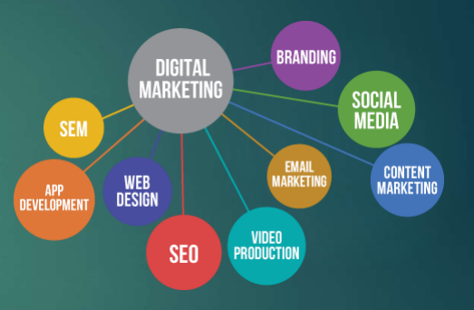
DIGITAL MARKETING AREAS
SEO (Search Engine Optimization)
SMO (Social Media Optimization)
SEM (Search Engine Marketing)
SMM(Social Media Marketing)

Slide 13


